Slide 1
W4111 – Introduction to Databases Section 003, V03, Fall 2024 Lecture 6: ER(5), Relational(5), SQL(5)
© Donald F. Ferguson, 2024

Slide 2
W4111 – Introduction to Databases Section 003, V03, Fall 2024 Lecture 6: ER(5), Relational(5), SQL(5)
We will start in a few minutes.
© Donald F. Ferguson, 2024

Slide 3

Today’s Contents
3 | COMS W4111_003_2024_3: Lecture 6: ER(5), Relational(5), SQL(5) © Donald F. Ferguson, 2024

Slide 4
Contents
Introduction and course updates.
Midterm
Questions
Codd’s 12 Rules – Metadata.
Relational model and algebra (5).
SQL (5).
Some complete examples of modeling → implementation.

Slide 5
Introduction and course updates
5 | COMS W4111_003_2024_3: Lecture 6: ER(5), Relational(5), SQL(5) © Donald F. Ferguson, 2024

Slide 6
Course Updates
Midterm is 18-OCT-2024
CVN students will take online in a proctored environment.
Students have flexibility on day and time but must complete by 23-OCT at 11:59.
We will provide details and instructions on Ed.
Students registered with their school’s disability services will coordinate and follow the services instructions for taking the test.
All other students will take the exam in the classroom 309 Havemeyer from 10:10 AM until 11:30 AM. We will be strict with enforcing start and stop times.
A continuation lecture will be from 11:45 AM to 12:40 PM.
You may use one 8.5” by 11” double side “cheat sheet” that you create. You can choose the content that you put on your sheet.
The exam will be difficult. Will “curve” the scores. The exam will be long ➔ manage your time.
You are are responsible for:
Any topic covered in a lecture, even if covered verbally, answering a question, etc.
ANY material from ANY slide in the slide decks for lectures 1 through 6.
Any material in the slides for Ch1, Ch2, Ch3, Ch4, Ch5 (except for JDBC).
Ch6: You are responsible for understanding the concepts. The only modeling notation language for which you are responsible is Crow’s Foot Notation.

Slide 7
Codd’s 12 Rules Metadata
7 | COMS W4111_003_2024_3: Lecture 6: ER(5), Relational(5), SQL(5) © Donald F. Ferguson, 2024

Slide 8
Codd’s 12 Rules
Rule 1: Information Rule
The data stored in a database, may it be user data or metadata, must be a value of some table cell. Everything in a database must be stored in a table format.
Rule 2: Guaranteed Access Rule
Every single data element (value) is guaranteed to be accessible logically with a combination of table-name, primary-key (row value), and attribute-name (column value). No other means, such as pointers, can be used to access data.
Rule 3: Systematic Treatment of NULL Values
The NULL values in a database must be given a systematic and uniform treatment. This is a very important rule because a NULL can be interpreted as one the following − data is missing, data is not known, or data is not applicable.
Rule 4: Active Online Catalog
The structure description of the entire database must be stored in an online catalog, known as data dictionary, which can be accessed by authorized users. Users can use the same query language to access the catalog which they use to access the database itself.
Rule 5: Comprehensive Data Sub-Language Rule
A database can only be accessed using a language having linear syntax that supports data definition, data manipulation, and transaction management operations. This language can be used directly or by means of some application. If the database allows access to data without any help of this language, then it is considered as a violation.
Rule 6: View Updating Rule
All the views of a database, which can theoretically be updated, must also be updatable by the system.

Slide 9
Codd’s 12 Rules
Rule 7: High-Level Insert, Update, and Delete Rule
A database must support high-level insertion, updation, and deletion. This must not be limited to a single row, that is, it must also support union, intersection and minus operations to yield sets of data records.
Rule 8: Physical Data Independence
The data stored in a database must be independent of the applications that access the database. Any change in the physical structure of a database must not have any impact on how the data is being accessed by external applications.
Rule 9: Logical Data Independence
The logical data in a database must be independent of its user’s view (application). Any change in logical data must not affect the applications using it. For example, if two tables are merged or one is split into two different tables, there should be no impact or change on the user application. This is one of the most difficult rule to apply.
Rule 10: Integrity Independence
A database must be independent of the application that uses it. All its integrity constraints can be independently modified without the need of any change in the application. This rule makes a database independent of the front-end application and its interface.
Rule 11: Distribution Independence
The end-user must not be able to see that the data is distributed over various locations. Users should always get the impression that the data is located at one site only. This rule has been regarded as the foundation of distributed database systems.
Rule 12: Non-Subversion Rule
If a system has an interface that provides access to low-level records, then the interface must not be able to subvert the system and bypass security and integrity constraints.

Slide 10
Data Definition Language (DDL)
Specification notation for defining the database schema
Example: create table instructor ( ID char(5), name varchar(20), dept_name varchar(20), salary numeric(8,2))
DDL compiler generates a set of table templates stored in a data dictionary
Data dictionary contains metadata (i.e., data about data)
Database schema
Integrity constraints
Primary key (ID uniquely identifies instructors)
Authorization
Who can access what
Notes:
10

Slide 11
Metadata and Catalog
‘Metadata is "data that provides information about other data". In other words, it is "data about data". Many distinct types of metadata exist, including descriptive metadata, structural metadata, administrative metadata, reference metadata and statistical metadata.’ (https://en.wikipedia.org/wiki/Metadata)
“The database catalog of a database instance consists of metadata in which definitions of database objects such as base tables, views (virtual tables), synonyms, value ranges, indexes, users, and user groups are stored. ... ... The SQL standard specifies a uniform means to access the catalog, called the INFORMATION_SCHEMA, but not all databases follow this ...” (https://en.wikipedia.org/wiki/Database_catalog)
Codd’s Rule 4: Dynamic online catalog based on the relational model:
The data base description is represented at the logical level in the same way as ordinary data, so that authorized users can apply the same relational language to its interrogation as they apply to the regular data.

Slide 12
Data Dictionary Storage
The Data dictionary (also called system catalog) stores metadata; that is, data about data, such as
Information about relations
names of relations
names, types and lengths of attributes of each relation
names and definitions of views
integrity constraints
User and accounting information, including passwords
Statistical and descriptive data
number of tuples in each relation
Physical file organization information
How relation is stored (sequential/hash/…)
Physical location of relation
Information about indices (Chapter 14)

Slide 13
Relational Representation of System Metadata
Relational representation on disk
Specialized data structures designed for efficient access, in memory

Slide 14
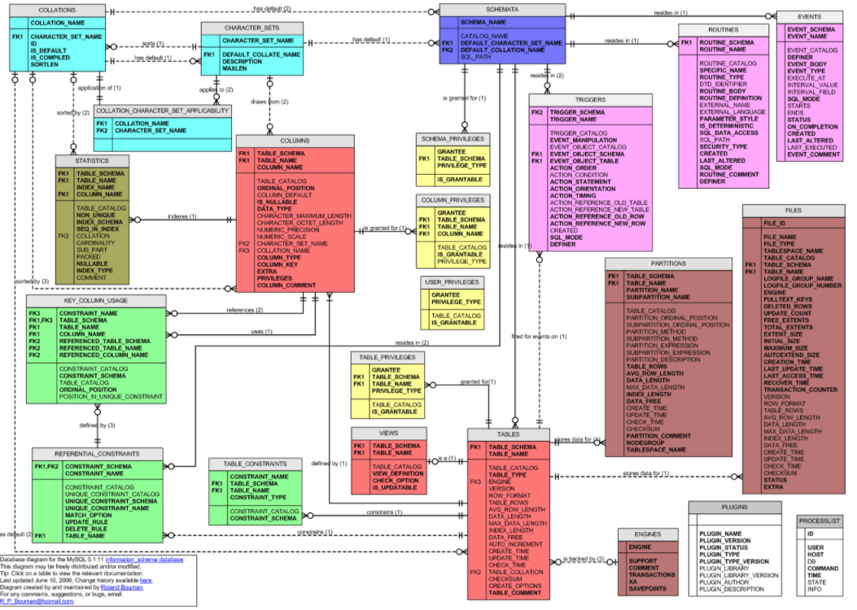
MySQL Catalog (Information_Schema)
Some of the MySQL Information Schema Tables:
'ADMINISTRABLE_ROLE_AUTHORIZATIONS'
'APPLICABLE_ROLES'
'CHARACTER_SETS'
'CHECK_CONSTRAINTS'
'COLUMN_PRIVILEGES'
'COLUMN_STATISTICS'
'COLUMNS'
'ENABLED_ROLES'
'ENGINES'
'EVENTS'
'FILES'
'KEY_COLUMN_USAGE'
'PARAMETERS'
'REFERENTIAL_CONSTRAINTS'
'RESOURCE_GROUPS'
'ROLE_COLUMN_GRANTS'
'ROLE_ROUTINE_GRANTS'
'ROLE_TABLE_GRANTS'
'ROUTINES'
'SCHEMA_PRIVILEGES'
'STATISTICS'
'TABLE_CONSTRAINTS'
'TABLE_PRIVILEGES'
'TABLES'
'TABLESPACES'
'TRIGGERS'
'USER_PRIVILEGES'
'VIEW_ROUTINE_USAGE'
'VIEW_TABLE_USAGE'
'VIEWS'
CREATE and ALTER statements modify the data.
DBMS reads information:
Parsing
Optimizer
etc.

Slide 15
Relational Algebra
15 | COMS W4111_003_2024_3: Lecture 6: ER(5), Relational(5), SQL(5) © Donald F. Ferguson, 2024

Slide 16
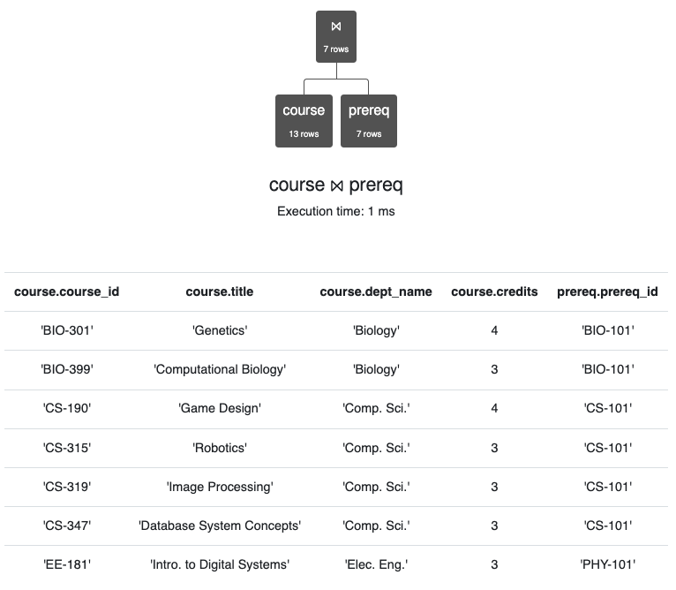
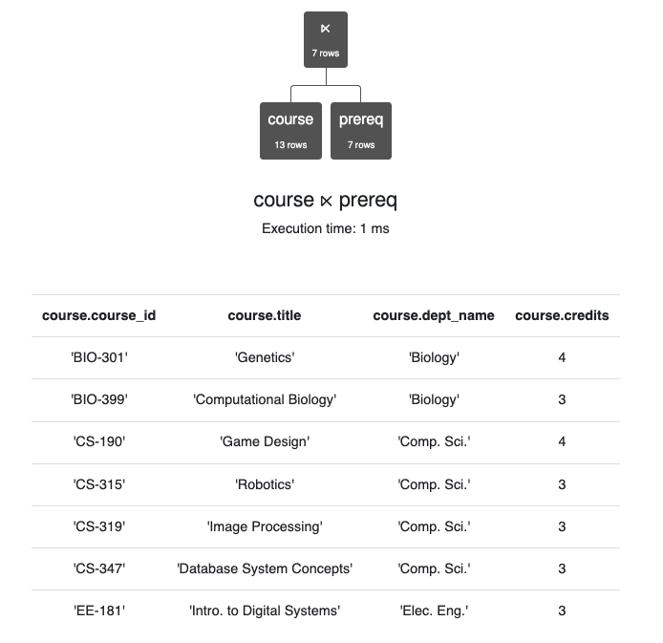
Semi-Join
Semi-join is a type of join that is applied to relations to join them based on the related columns. When semi-join is applied, it returns the rows from one table for which there are matching records in another related table.

Slide 17
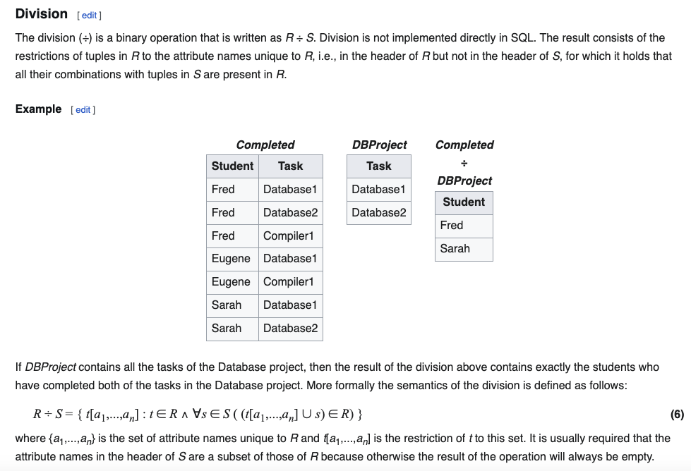
Division
Relax Example
X = π course_id←course_id (σ dept_name='History' (course))
Y = π ID←ID, course_id←course_id (student ⨝ takes)
Y ÷ X

Slide 18
Indexes
18 | COMS W4111_003_2024_3: Lecture 6: ER(5), Relational(5), SQL(5) © Donald F. Ferguson, 2024

Slide 19
Index Creation
Many queries reference only a small proportion of the records in a table.
It is inefficient for the system to read every record to find a record with particular value
An index on an attribute of a relation is a data structure that allows the database system to find those tuples in the relation that have a specified value for that attribute efficiently, without scanning through all the tuples of the relation.
We create an index with the create index command
create index <name> on <relation-name> (attribute);

Slide 20
Index Creation Example
create table student (ID varchar (5), name varchar (20) not null, dept_name varchar (20), tot_cred numeric (3,0) default 0, primary key (ID))
create index studentID_index on student(ID)
The query:
select * from student where ID = '12345'
can be executed by using the index to find the required record, without looking at all records of student
DFF:
An index on (column1, column2, column3)
Is also an index on (column1) and (column1, column2)
But not (column2), (column3), (column2, column3).
We will see “why” later in the semester.

Slide 21
Functions, Procedures, Triggers
21 | COMS W4111_003_2024_3: Lecture 6: ER(5), Relational(5), SQL(5) © Donald F. Ferguson, 2024

Slide 22

Some Concepts
22 | COMS W4111_003_2024_3: Lecture 6: ER(5), Relational(5), SQL(5) © Donald F. Ferguson, 2024

Slide 23
Functions and Procedures
Functions and procedures allow “business logic” to be stored in the database and executed from SQL statements.
These can be defined either by the procedural component of SQL or by an external programming language such as Java, C, or C++.
The syntax we present here is defined by the SQL standard.
Most databases implement nonstandard versions of this syntax.
Note:
The programming language, runtime and tools for functions, procedures and triggers are not easy to use.
My view is that calling external functions is an anti-pattern (bad idea).
External code degrades the reliability, security and performance of the database.
Databases are often mission critical and the heart of environments.

Slide 24
Language Constructs for Procedures & Functions
SQL supports constructs that gives it almost all the power of a general-purpose programming language.
Warning: most database systems implement their own variant of the standard syntax below.
Compound statement: begin … end, {}
May contain multiple SQL statements between begin and end.
Local variables can be declared within a compound statements
While and repeat statements:
while boolean expression do
sequence of statements ;
end while
repeat
sequence of statements ;
until boolean expression
end repeat

Slide 25
(Core) Language Constructs (Cont.)
For loop
Permits iteration over all results of a query
Example: Find the budget of all departments declare n integer default 0; for r as select budget from department where dept_name = 'Music' do set n = n + r.budget end for
Note:
There are various other looping constructs.

Slide 26
(Core) Language Constructs – if-then-else
Conditional statements (if-then-else)
if boolean expression then statement or compound statement elseif boolean expression then statement or compound statement else statement or compound statement end if
Note:
We will not spend a lot of time writing functions, procedures, or triggers.
The language and development environment are not easy to use.

Slide 27
Functions
27 | COMS W4111_003_2024_3: Lecture 6: ER(5), Relational(5), SQL(5) © Donald F. Ferguson, 2024

Slide 28
Declaring SQL Functions
Define a function that, given the name of a department, returns the count of the number of instructors in that department.
create function dept_count (dept_name varchar(20)) returns integer begin declare d_count integer; select count (* ) into d_count from instructor where instructor.dept_name = dept_name return d_count; end
The function dept_count can be used to find the department names and budget of all departments with more that 12 instructors.
select dept_name, budget from department where dept_count (dept_name ) > 12

Slide 29
Table Functions
The SQL standard supports functions that can return tables as results; such functions are called table functions
Example: Return all instructors in a given department
create function instructor_of (dept_name char(20))
returns table (
ID varchar(5), name varchar(20), dept_name varchar(20), salary numeric(8,2))
return table (select ID, name, dept_name, salary from instructor where instructor.dept_name = instructor_of.dept_name)
Usage
select * from table (instructor_of ('Music'))

Slide 30
Procedures
30 | COMS W4111_003_2024_3: Lecture 6: ER(5), Relational(5), SQL(5) © Donald F. Ferguson, 2024

Slide 31
SQL Procedures
The dept_count function could instead be written as procedure:
create procedure dept_count_proc (in dept_name varchar(20), out d_count integer) begin
select count(*) into d_count from instructor where instructor.dept_name = dept_count_proc.dept_name
end
The keywords in and out are parameters that are expected to have values assigned to them and parameters whose values are set in the procedure in order to return results.
Procedures can be invoked either from an SQL procedure or from embedded SQL, using the call statement.
declare d_count integer; call dept_count_proc( 'Physics', d_count);

Slide 32
SQL Procedures (Cont.)
Procedures and functions can be invoked also from dynamic SQL
SQL allows more than one procedure of the so long as the number of arguments of the procedures with the same name is different.
The name, along with the number of arguments, is used to identify the procedure.

Slide 33
Triggers
33 | COMS W4111_003_2024_3: Lecture 6: ER(5), Relational(5), SQL(5) © Donald F. Ferguson, 2024

Slide 34
Triggers
A trigger is a statement that is executed automatically by the system as a side effect of a modification to the database.
To design a trigger mechanism, we must:
Specify the conditions under which the trigger is to be executed.
Specify the actions to be taken when the trigger executes.
Triggers introduced to SQL standard in SQL:1999, but supported even earlier using non-standard syntax by most databases.
Syntax illustrated here may not work exactly on your database system; check the system manuals
X on T
before insert
before update
before delete
after insert
after update
after delete

Slide 35
Triggering Events and Actions in SQL
Triggering event can be insert, delete or update
Triggers on update can be restricted to specific attributes
For example, after update of takes on grade
Values of attributes before and after an update can be referenced
referencing old row as : for deletes and updates
referencing new row as : for inserts and updates
Triggers can be activated before an event, which can serve as extra constraints. For example, convert blank grades to null.
create trigger setnull_trigger before update of takes referencing new row as nrow for each row when (nrow.grade = ' ') begin atomic set nrow.grade = null; end;

Slide 36
Trigger to Maintain credits_earned value
create trigger credits_earned after update of takes on (grade) referencing new row as nrow referencing old row as orow for each row when nrow.grade <> 'F' and nrow.grade is not null and (orow.grade = 'F' or orow.grade is null) begin atomic update student set tot_cred= tot_cred + (select credits from course where course.course_id= nrow.course_id) where student.id = nrow.id; end;

Slide 37
Statement Level Triggers
Instead of executing a separate action for each affected row, a single action can be executed for all rows affected by a transaction
Use for each statement instead of for each row
Use referencing old table or referencing new table to refer to temporary tables (called transition tables) containing the affected rows
Can be more efficient when dealing with SQL statements that update a large number of rows

Slide 38
When Not To Use Triggers
Triggers were used earlier for tasks such as
Maintaining summary data (e.g., total salary of each department)
Replicating databases by recording changes to special relations (called change or delta relations) and having a separate process that applies the changes over to a replica
There are better ways of doing these now:
Databases today provide built in materialized view facilities to maintain summary data
Databases provide built-in support for replication
Encapsulation facilities can be used instead of triggers in many cases
Define methods to update fields
Carry out actions as part of the update methods instead of through a trigger

Slide 39
When Not To Use Triggers (Cont.)
Risk of unintended execution of triggers, for example, when
Loading data from a backup copy
Replicating updates at a remote site
Trigger execution can be disabled before such actions.
Other risks with triggers:
Error leading to failure of critical transactions that set off the trigger
Cascading execution

Slide 40
Summary
40 | COMS W4111_003_2024_3: Lecture 6: ER(5), Relational(5), SQL(5) © Donald F. Ferguson, 2024

Slide 41
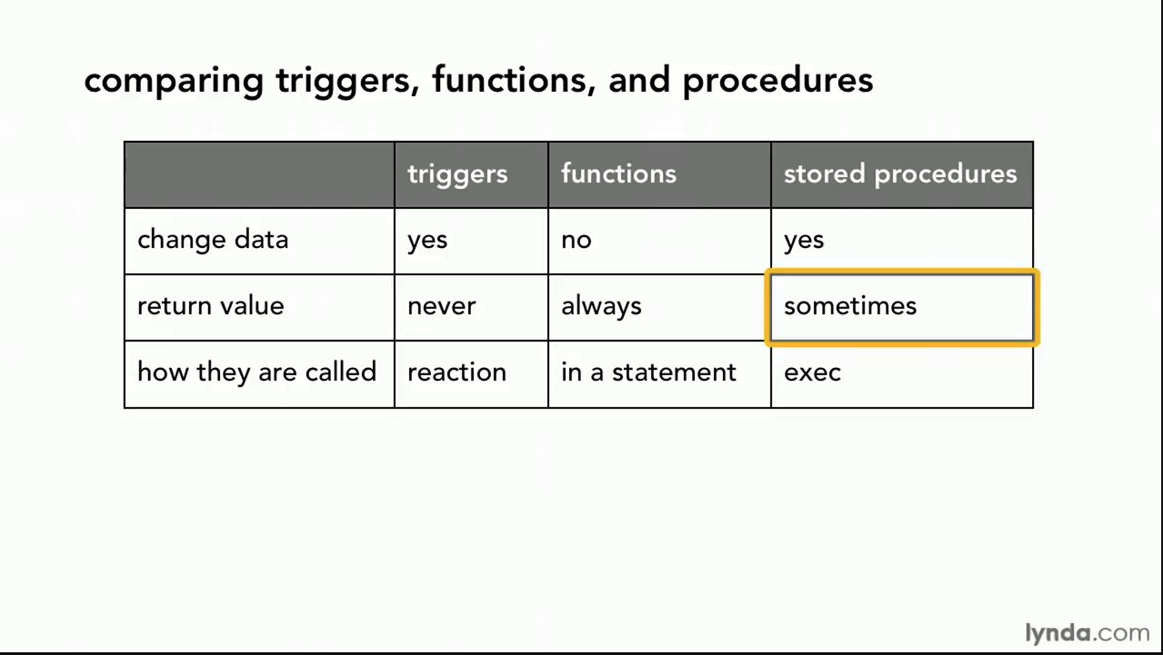
Comparison

Slide 42
Comparison – Some Details
A trigger has capabilities like a procedure, except ...
You do not call it. The DB engine calls it before or after an INSERT, UPDATE, DELETE.
The inputs are the list of incoming new, modified rows.
The outputs are the modified versions of the new or modified rows.

Slide 43
Authorization
43 | COMS W4111_003_2024_3: Lecture 6: ER(5), Relational(5), SQL(5) © Donald F. Ferguson, 2024

Slide 44
Security Concepts (Terms from Wikipedia)
Definitions:
“A (digital) identity is information on an entity used by computer systems to represent an external agent. That agent may be a person, organization, application, or device.”
“Authentication is the act of proving an assertion, such as the identity of a computer system user. In contrast with identification, the act of indicating a person or thing's identity, authentication is the process of verifying that identity.”
“Authorization is the function of specifying access rights/privileges to resources, ... More formally, "to authorize" is to define an access policy. ... During operation, the system uses the access control rules to decide whether access requests from (authenticated) consumers shall be approved (granted) or disapproved.
“Within an organization, roles are created for various job functions. The permissions to perform certain operations are assigned to specific roles. Members or staff (or other system users) are assigned particular roles, and through those role assignments acquire the permissions needed to perform particular system functions.”
“In computing, privilege is defined as the delegation of authority to perform security-relevant functions on a computer system. A privilege allows a user to perform an action with security consequences. Examples of various privileges include the ability to create a new user, install software, or change kernel functions.”
SQL and relational database management systems implementing security by:
Creating identities and authentication policies.
Creating roles and assigning identities to roles.
Granting and revoking privileges to/from roles and identities.

Slide 45
Authorization
We may assign a user several forms of authorizations on parts of the database.
Read - allows reading, but not modification of data.
Insert - allows insertion of new data, but not modification of existing data.
Update - allows modification, but not deletion of data.
Delete - allows deletion of data.
Each of these types of authorizations is called a privilege. We may authorize the user all, none, or a combination of these types of privileges on specified parts of a database, such as a relation or a view.

Slide 46
Authorization (Cont.)
Forms of authorization to modify the database schema
Index - allows creation and deletion of indices.
Resources - allows creation of new relations.
Alteration - allows addition or deletion of attributes in a relation.
Drop - allows deletion of relations.

Slide 47
Authorization Specification in SQL
The grant statement is used to confer authorization
grant <privilege list> on <relation or view > to <user list>
<user list> is:
a user-id
public, which allows all valid users the privilege granted
A role (more on this later)
Example:
grant select on department to Amit, Satoshi
Granting a privilege on a view does not imply granting any privileges on the underlying relations.
The grantor of the privilege must already hold the privilege on the specified item (or be the database administrator).

Slide 48
Privileges in SQL
select: allows read access to relation, or the ability to query using the view
Example: grant users U₁, U₂, and U₃ select authorization on the instructor relation:
grant select on instructor to U₁, U₂, U₃
insert: the ability to insert tuples
update: the ability to update using the SQL update statement
delete: the ability to delete tuples.
all privileges: used as a short form for all the allowable privileges

Slide 49
Revoking Authorization in SQL
The revoke statement is used to revoke authorization.
revoke <privilege list> on <relation or view> from <user list>
Example:
revoke select on student from U₁, U₂, U₃
<privilege-list> may be all to revoke all privileges the revokee may hold.
If <revokee-list> includes public, all users lose the privilege except those granted it explicitly.
If the same privilege was granted twice to the same user by different grantees, the user may retain the privilege after the revocation.
All privileges that depend on the privilege being revoked are also revoked.

Slide 50
Roles
A role is a way to distinguish among various users as far as what these users can access/update in the database.
To create a role we use:
create a role <name>
Example:
create role instructor
Once a role is created we can assign “users” to the role using:
grant <role> to <users>

Slide 51
Roles Example
create role instructor;
grant instructor to Amit;
Privileges can be granted to roles:
grant select on takes to instructor;
Roles can be granted to users, as well as to other roles
create role teaching_assistant
grant teaching_assistant to instructor;
Instructor inherits all privileges of teaching_assistant
Chain of roles
create role dean;
grant instructor to dean;
grant dean to Satoshi;

Slide 52
Authorization on Views
create view geo_instructor as (select * from instructor where dept_name = 'Geology');
grant select on geo_instructor to geo_staff
Suppose that a geo_staff member issues
select * from geo_instructor;
What if
geo_staff does not have permissions on instructor?
Creator of view did not have some permissions on instructor?

Slide 53
Other Authorization Features
references privilege to create foreign key
grant reference (dept_name) on department to Mariano;
Why is this required?
transfer of privileges
grant select on department to Amit with grant option;
revoke select on department from Amit, Satoshi cascade;
revoke select on department from Amit, Satoshi restrict;
And more!
Note:
Like in many other cases, SQL DBMS have product specific variations.
Switch to notebook.

Slide 54
Some Advanced SQL
54 | COMS W4111_003_2024_3: Lecture 6: ER(5), Relational(5), SQL(5) © Donald F. Ferguson, 2024

Slide 55
WITH Clause
Common Table Expressions
55 | COMS W4111_003_2024_3: Lecture 6: ER(5), Relational(5), SQL(5) © Donald F. Ferguson, 2024

Slide 56
With Clause
The with clause provides a way of defining a temporary relation whose definition is available only to the query in which the with clause occurs.
Find all departments with the maximum budget with max_budget (value) as (select max(budget) from department) select department.name from department, max_budget where department.budget = max_budget.value;

Slide 57
Complex Queries using With Clause
Find all departments where the total salary is greater than the average of the total salary at all departments
with dept _total (dept_name, value) as
(select dept_name, sum(salary)
from instructor
group by dept_name),
dept_total_avg(value) as
(select avg(value)
from dept_total)
select dept_name
from dept_total, dept_total_avg
where dept_total.value > dept_total_avg.value;

Slide 58
Common Table Expressions
CTE: (https://www.essentialsql.com/introduction-common-table-expressions-ctes/)
“The Common Table Expressions or CTE’s for short are used within SQL (...) to simplify complex joins and subqueries, ...”
“A CTE (Common Table Expression) defines a temporary result set which you can then use in a SELECT statement. It becomes a convenient way to manage complicated queries.”
There are two types of CTEs:
Non-recursive.
Recursive (note, recursive SQL weirds me out).
The benefits are clarity and improved quality through incremental development.
Basic syntax by example.
There may be several CTEs.
A CTE can reference other CTEs.

Slide 59
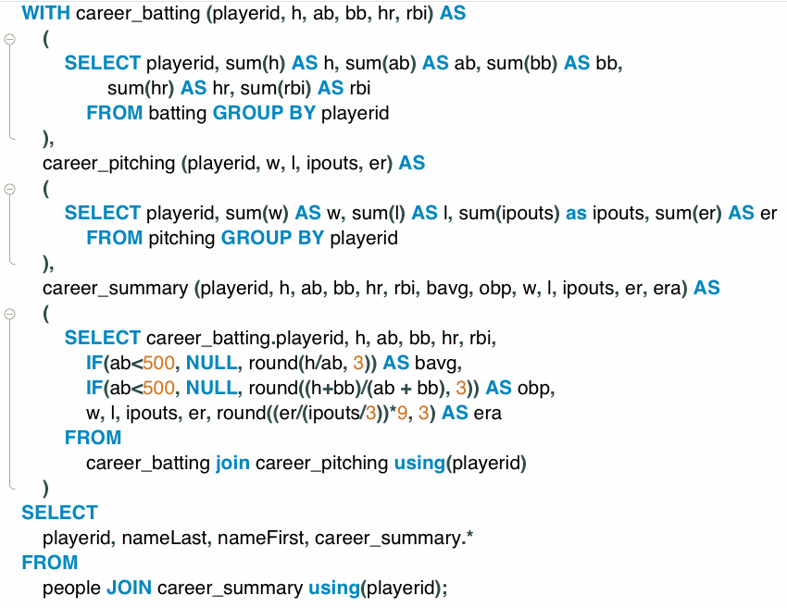
Common Table Expressions – Example
Producing a career summary requires several tasks:
Computing batting totals
Computing pitching totals
Applying formulas to produce derived averages and metrics.
Joining (1), (2) and (3) into a career summary.
Joining with people to bring in personal information.
Producing the table is possible with a single SELECT statement, but ... ...
Developing incrementally one simpler query at a time is easier.
The resulting query is easier to understand and maintain.

Slide 60
Common Table Expressions – Example
Producing a career summary requires several tasks:
Computing batting totals
Computing pitching totals
Applying formulas to produce derived averages and metrics.
Joining (1), (2) and (3) into a career summary.
Joining with people to bring in personal information.
Producing the table is possible with a single SELECT statement, but ... ...
Developing incrementally one simpler query at a time is easier.
The resulting query is easier to understand and maintain.
I find it difficult to impossible to write complex queries without using CTEs.
I think about incremental steps to produce the result.
Write and test the CTE by adding one step at a time.
Please, please, please:
Use CTEs.
Use DataGrip

Slide 61
Recursive Queries
61 | COMS W4111_003_2024_3: Lecture 6: ER(5), Relational(5), SQL(5) © Donald F. Ferguson, 2024

Slide 62
Recursion in SQL
SQL:1999 permits recursive view definition
Example: find which courses are a prerequisite, whether directly or indirectly, for a specific course with recursive rec_prereq(course_id, prereq_id) as ( select course_id, prereq_id from prereq union select rec_prereq.course_id, prereq.prereq_id, from rec_rereq, prereq where rec_prereq.prereq_id = prereq.course_id ) select ∗ from rec_prereq;
This example view, rec_prereq, is called the transitive closure of the prereq relation

Slide 63
The Power of Recursion
Recursive views make it possible to write queries, such as transitive closure queries, that cannot be written without recursion or iteration.
Intuition: Without recursion, a non-recursive non-iterative program can perform only a fixed number of joins of prereq with itself
This can give only a fixed number of levels of managers
Given a fixed non-recursive query, we can construct a database with a greater number of levels of prerequisites on which the query will not work
Alternative: write a procedure to iterate as many times as required
See procedure findAllPrereqs in book
Since SQL is not Turing complete, there are many computations it cannot perform.
Recursion enables some scenarios, but recursion in general is hard to understand.
Switch to notebook

Slide 64
Advanced Aggregation
Window Functions
64 | COMS W4111_003_2024_3: Lecture 6: ER(5), Relational(5), SQL(5) © Donald F. Ferguson, 2024

Slide 65
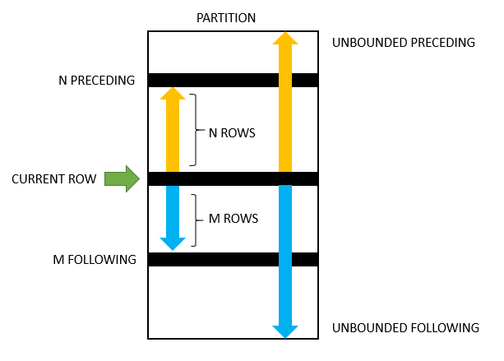
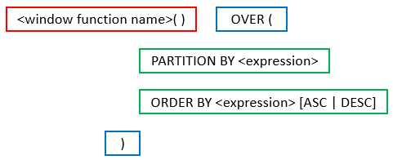
Advanced Aggregates and Window Functions
The aggregation functions in SQL are powerful.
There are some scenarios that are very difficult. SQL and databases add support for more advanced capabilities:
Ranking
Windows
Pivot, Slice and Dice, but we will cover these with a different technology (OLAP) later in the semester.
This is powerful, a little complex and requires trial and error.

Slide 66
Classic Models: Annual Revenue and YoY Growth by Country
SELECT country, YEAR(orderDate) AS year, ROUND(SUM(priceEach * quantityOrdered), 2) AS annual_revenue, ROUND( (SUM(priceEach * quantityOrdered) - LAG(SUM(priceEach * quantityOrdered)) OVER (PARTITION BY country ORDER BY YEAR(orderDate))) / LAG(SUM(priceEach * quantityOrdered)) OVER (PARTITION BY country ORDER BY YEAR(orderDate)) * 100, 2 ) AS yoy_growth_percentage FROM customers JOIN orders ON customers.customerNumber = orders.customerNumber JOIN orderdetails ON orders.orderNumber = orderdetails.orderNumber GROUP BY country, year ORDER BY country, year;

Slide 67
ER Modeling and Realization
67 | COMS W4111_003_2024_3: Lecture 6: ER(5), Relational(5), SQL(5) © Donald F. Ferguson, 2024

Slide 68
Some Concepts
68 | COMS W4111_003_2024_3: Lecture 6: ER(5), Relational(5), SQL(5) © Donald F. Ferguson, 2024

Slide 69
Complex Attributes
Attribute types:
Simple and composite attributes.
Single-valued and multivalued attributes
Example: multivalued attribute: phone_numbers
Derived attributes
Can be computed from other attributes
Example: age, given date_of_birth
Domain – the set of permitted values for each attribute

Slide 70
Composite Attributes
Composite attributes allow us to divided attributes into subparts (other attributes).

Slide 71
Entity Attributes
The relational model and well-designed SQL schema have atomic attributes.
There are several ways to think about attributes:
Simple (Atomic) vs Composite
Single Valued versus Multi-valued
Derived or Not Derived
And, there can be combinations, for example a Composite, Multi-Value Attribute. Phone number is an example:
A phone number is a composite (+1, 914-555-1212)
A customer may have several: work, home, mobile, … …
Examining name_basics from the IMDB dataset is interesting.

Slide 72
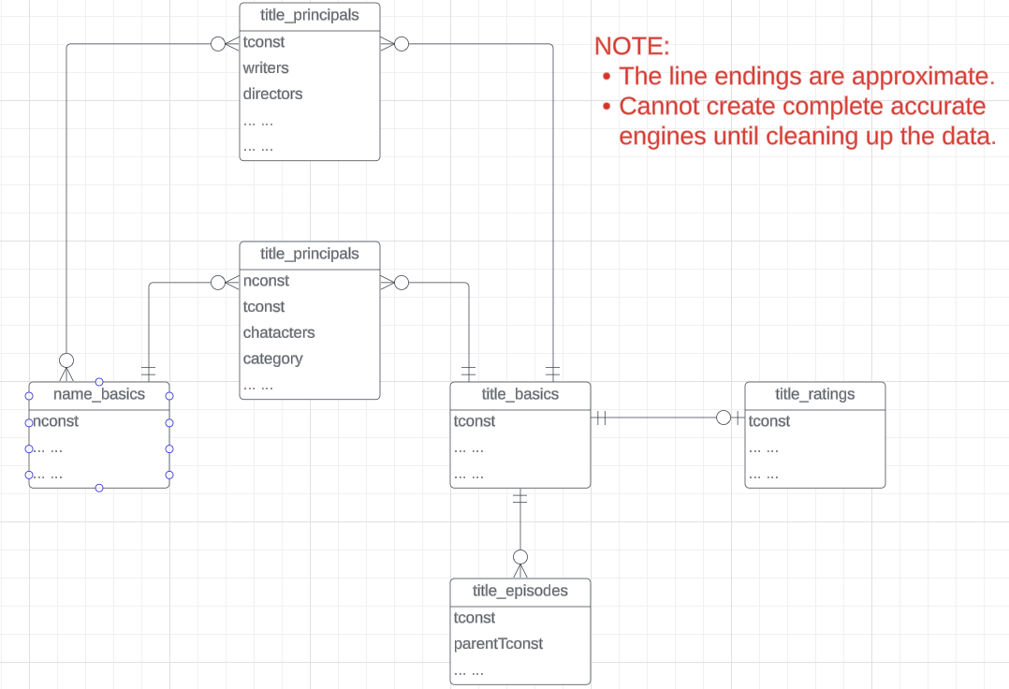
IMDB Free Data
IMDB Free Dataset is a set of TSV files:
Title Basics
Title AKAS
Title Crew
Title Episodes
Title Principals
Title Ratings
Name Basics
The data needs a lot of “clean up.”
See /Users/donald.ferguson/Dropbox/000/000-A-Current-Examples/IMDB_GOT_Processing

Slide 73
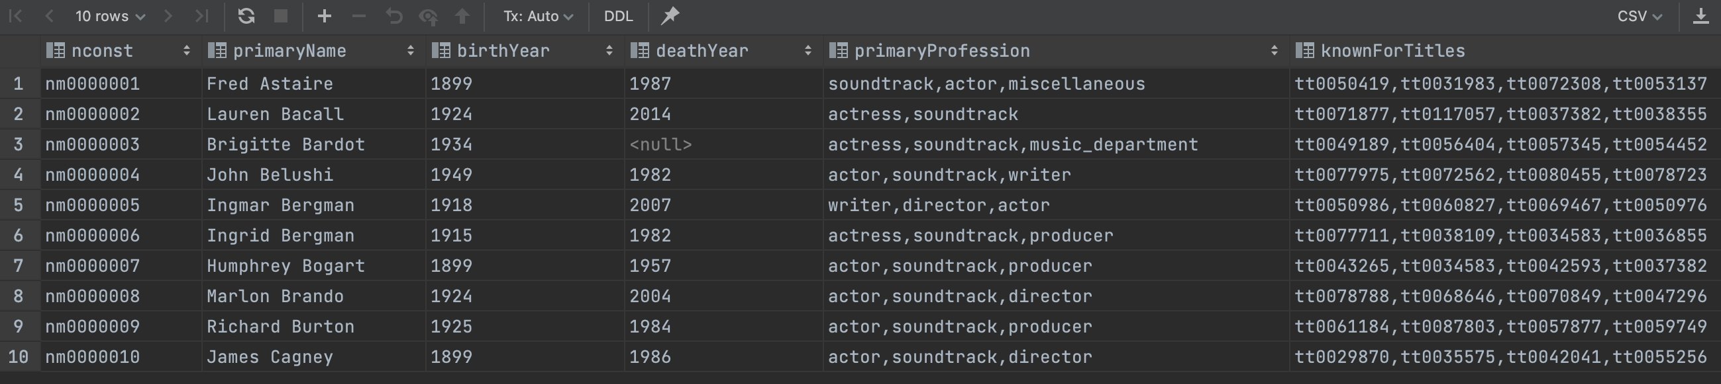
Example from IMDB
Switch to notebook
Consider name_basics
There
Is one composite attribute, primaryName.
Are two multivalued attributes: primaryProfession, knownForTitles
knownForTitles is also tricky, which we will see.
Names are also a little tricky

Slide 74
Worked Example
74 | COMS W4111_003_2024_3: Lecture 6: ER(5), Relational(5), SQL(5) © Donald F. Ferguson, 2024

Slide 75
Worked Example
Person, Student, Faculty, Course, Section entity types.
Student and Faculty specialize Person.
Person, Student, Faculty:
Overlapping
Complete
Functions and encapsulation:
Hide base tables and protect with authorization rules.
get_next_uni() function.
Use a trigger to make the UNI idempotent.
Stored procedures for insert, update, delete.

